Slide 1
Assignment 4
Marissa Defratti

Slide 2
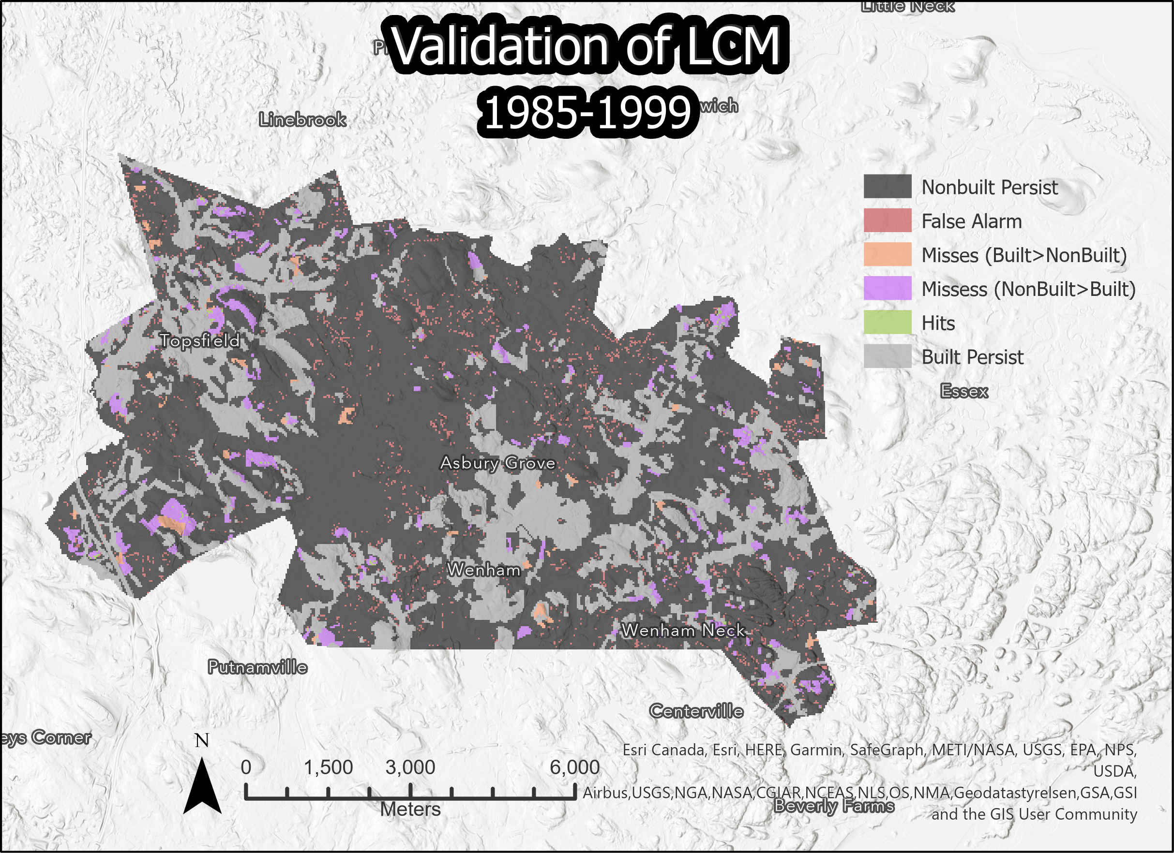
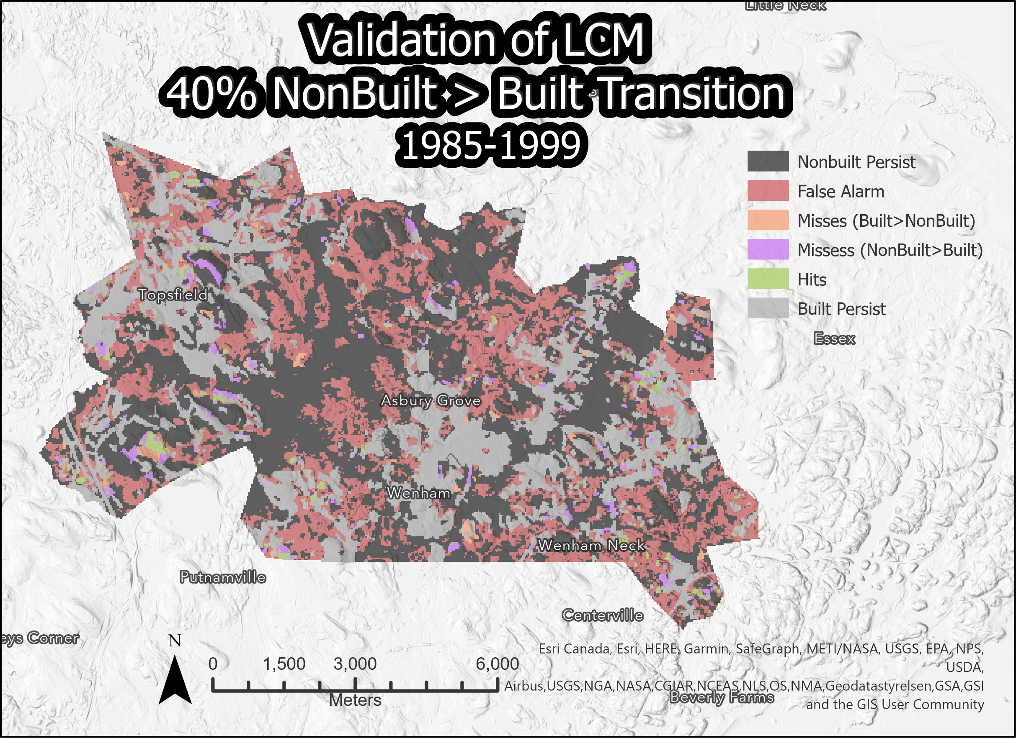
Markov Matrix Cross Validatons
Notes:
Both CROSSTAB validations; describe how Markov Matrix relates to # of Misses, Hits, False Alarms
Each Map as 6 legend entries; legend follows color palette that highlights categories relevant to answers; North Arrow & Scale bar

Slide 3
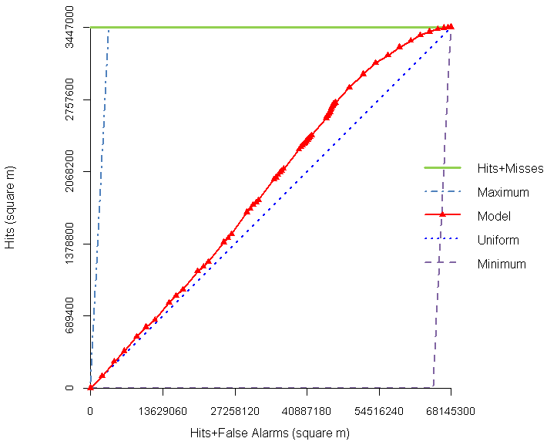
TOC Curve
Notes:
TOC Curve; How it relates to the 2 CROSSTAB validation maps & transition potential map3
The TOC curve displays how well the transition potential model compared to the actual transitioned pixels in 1999. The first CROSSTAB map used the number of built pixels from 1999 as the input quantity, then LCM was used to determine the allocation. For the second CROSSTAB map, the Markov Matrix was specified to reserve 60% of the NonBuilt pixels as NonBuilt and allocate 40% of them to transition to Built; also Built pixels were constricted to have 0 transitions. The second run severely overestimated the quantity of pixels to allocate, and therefore ended up with a high number of false alarms. However, the TOC curve can be useful to determine the quantity of pixels to allocate, and the transition suitability can be useful to determine where to allocate, but also to understand the number of ‘most suitable’ pixels for allocation.

Slide 4
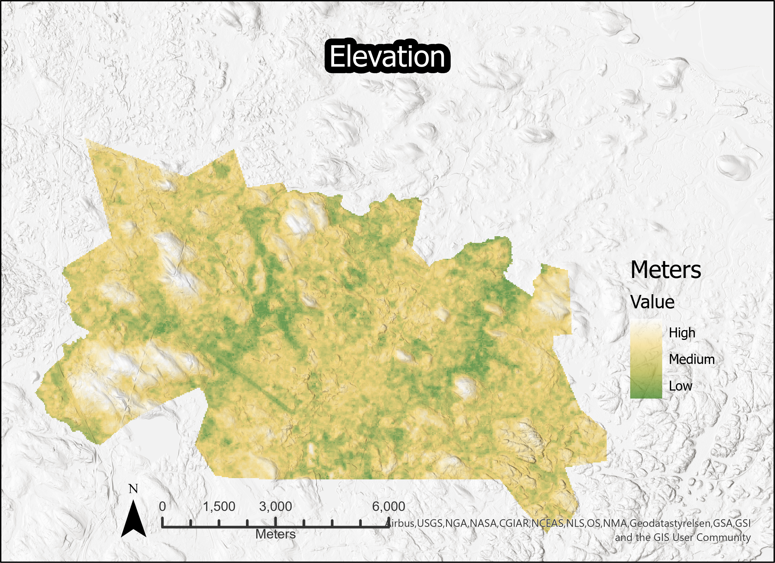
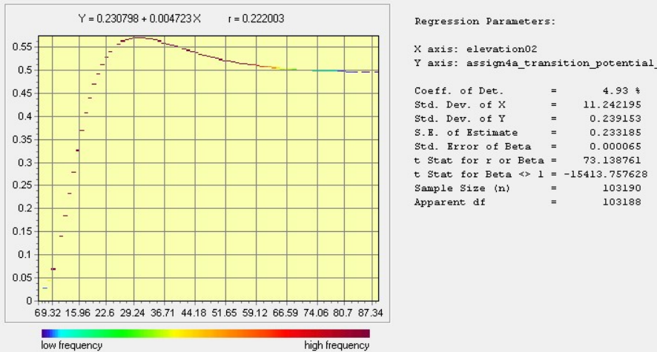
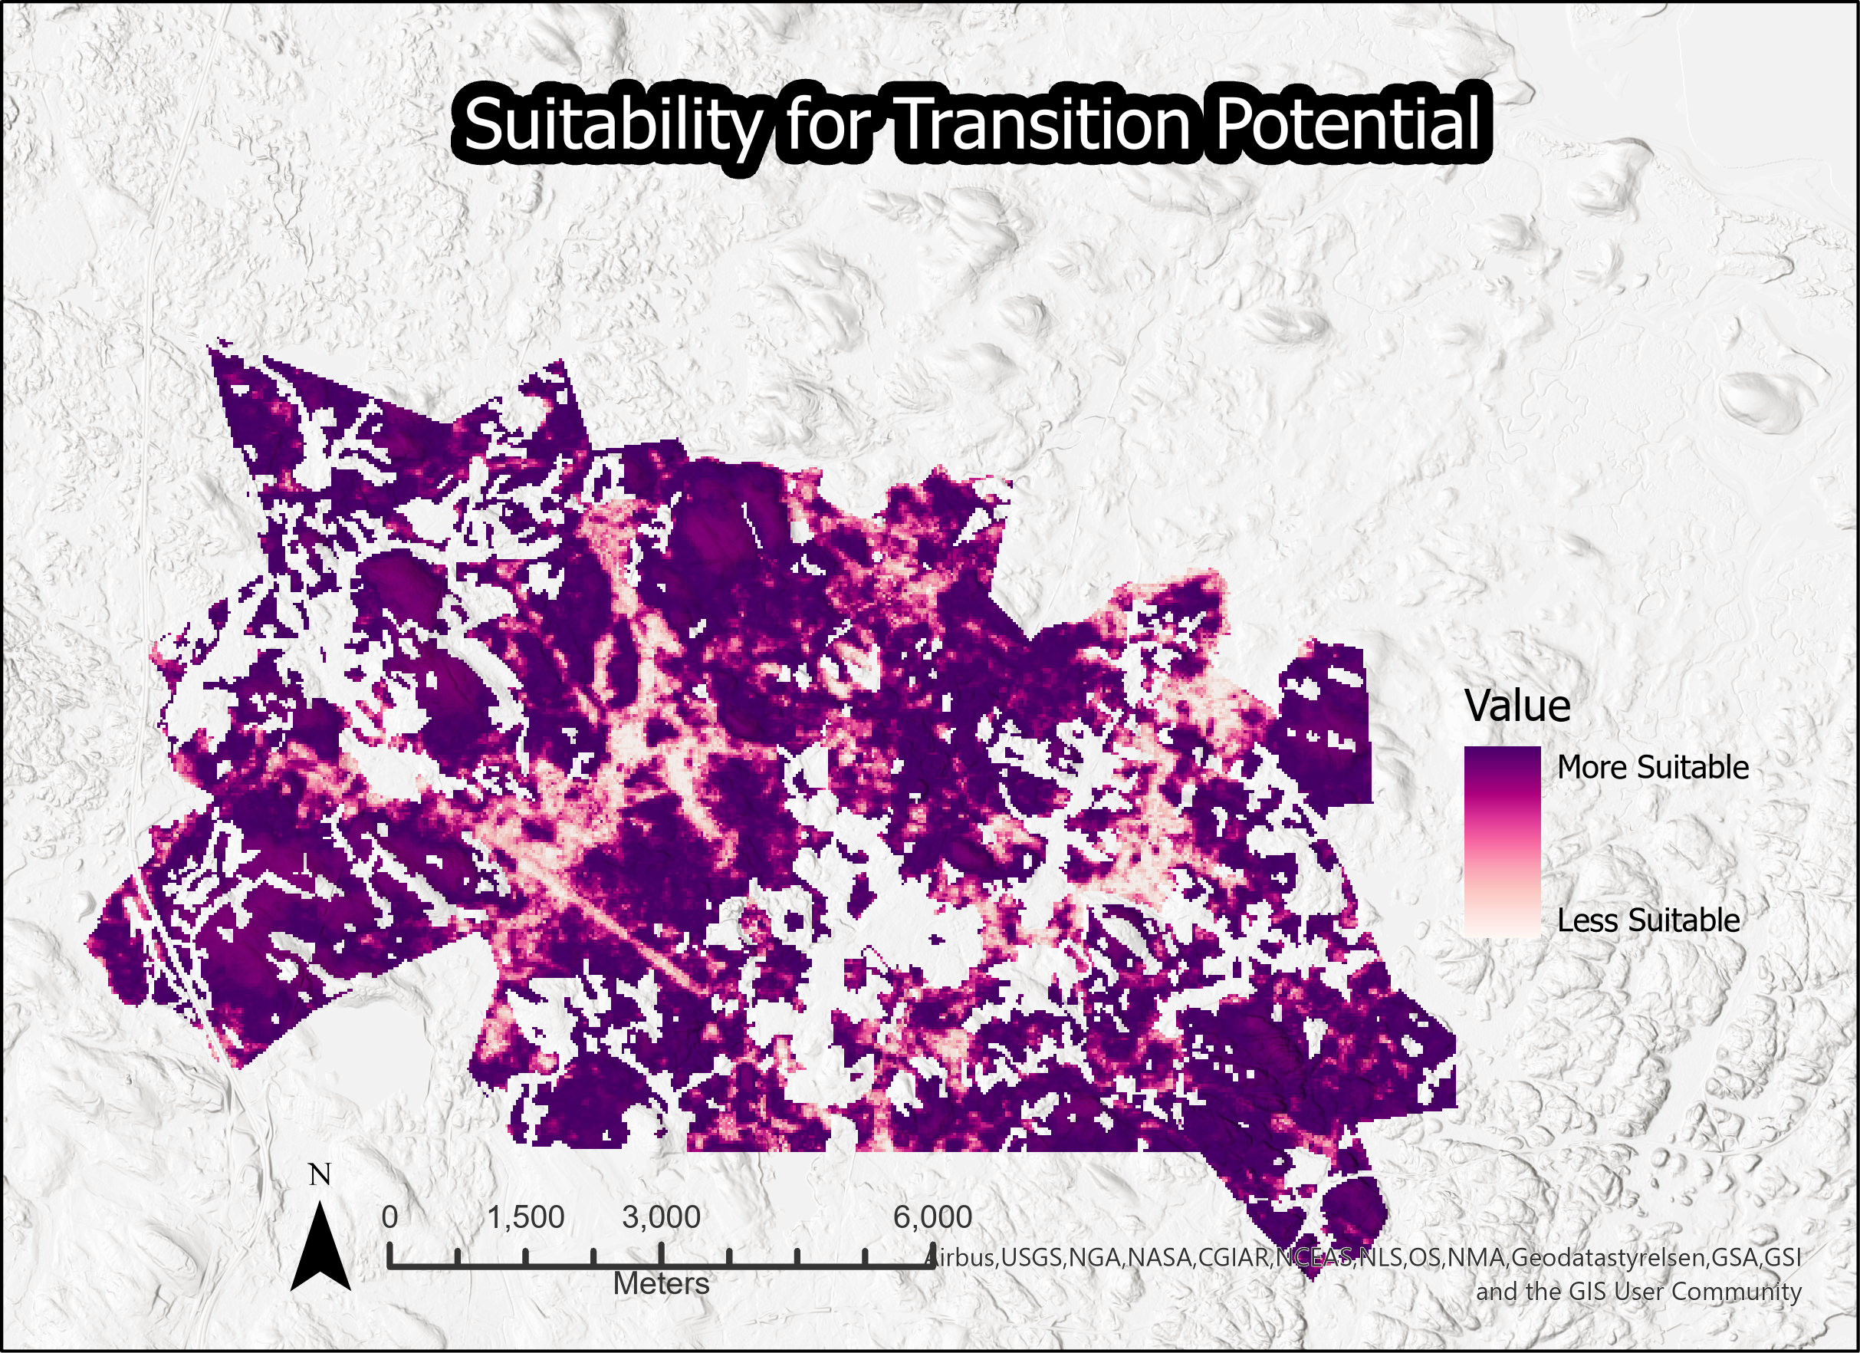
Transition Potential of Elevations
Notes:
Elevation02map + Transition Potential Map (color palette + north arrow + scale bar) + REGRESS Plot -> What is the relationship between all 3?
The regression plot relates elevation to the suitability for transition potential. The first section of the line shows the potential for the lowest elevation – mostly unsuitable because the majority of it is already built on. The section near the peak shows the most suitable elevations, and the down slope after that shows elevations that are still suitable, but that slightly decrease as elevation increases.

